Slide 1






Advanced image processing with MorphoLibJ
David Legland, Ignacio Arganda-Carreras, Philippe Andrey
david.legland@inrae.fr
NEUBIAS Academy @Home
April 30th, 2020

Slide 2
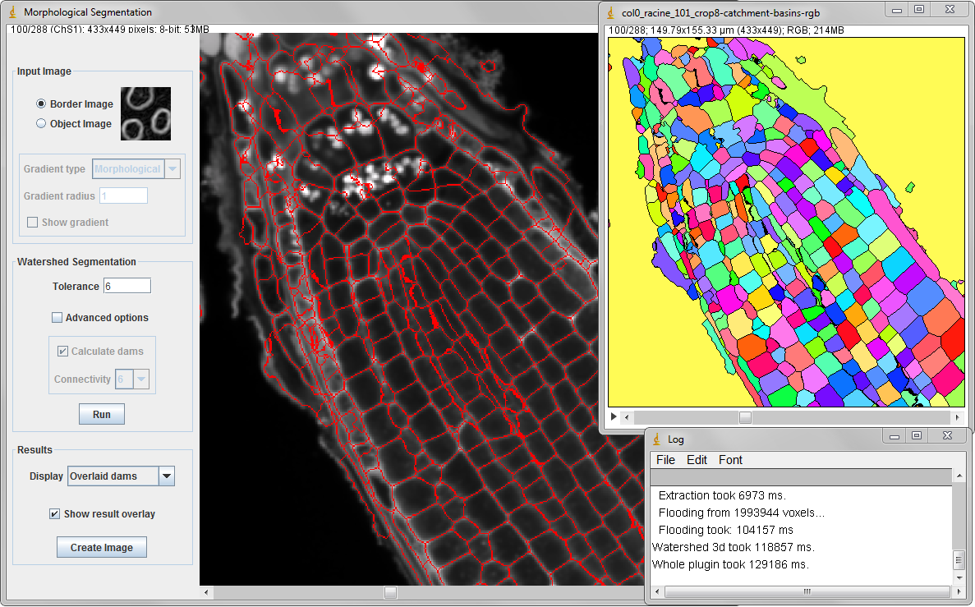


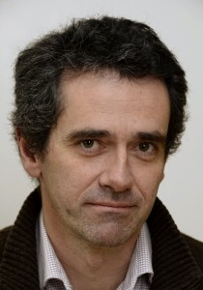

Context
Image analysis and modelling team at IJPB
Development of methods and algorithms
Large use of mathematical morphology
ImageJ / Fiji
Widely used by (plant) biologists
Few or limited existing MM plugins
=> MorphoLibJ

Slide 3
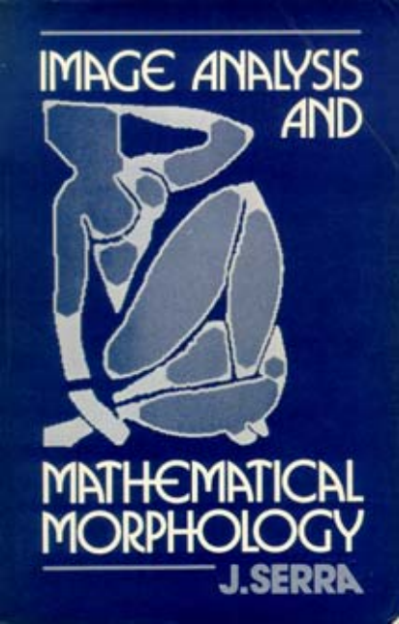

Mathematical Morphology?
Set-theoretic approach for image analysis
Developed by G. Matheron and J. Serra (1960+)
2D, 3D... ND images
Graphs, meshes….
Many operators to link together:
Morphological filtering
Skeleton
Watershed...
References
Serra (1982)
Soille (2003)

Slide 4
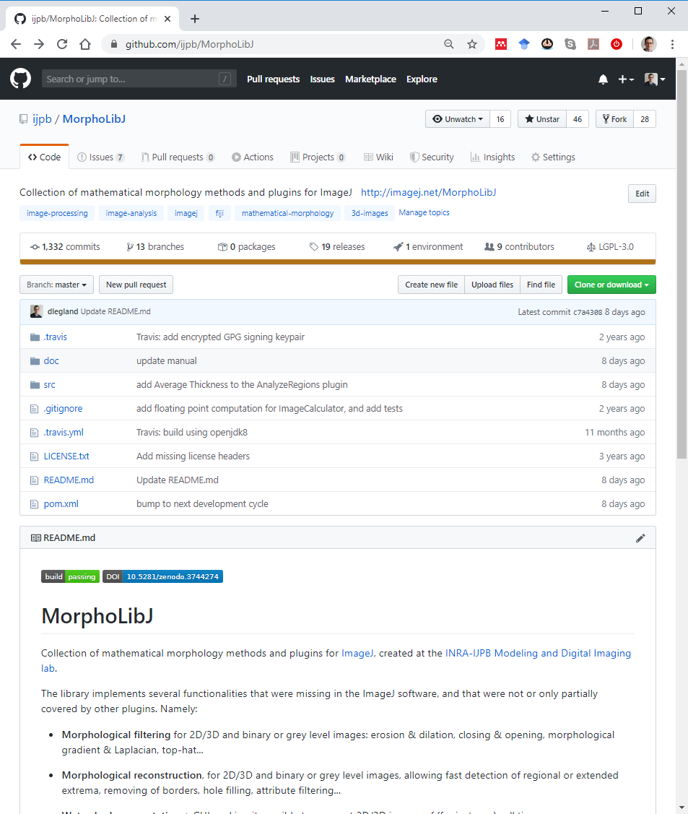
The MorphoLibJ library
Collection of ImageJ plugins
Provides implementation of many Mathematical Morphology algorithms
with GUI
Main page:
http://imagej.net/MorphoLibJ
Source code, user manual:
http://github.com/ijpb/MorphoLibJ/
Sample data (and demo plugins):
https://github.com/dlegland/mathematical_morphology_with_MorphoLibJ

Slide 5
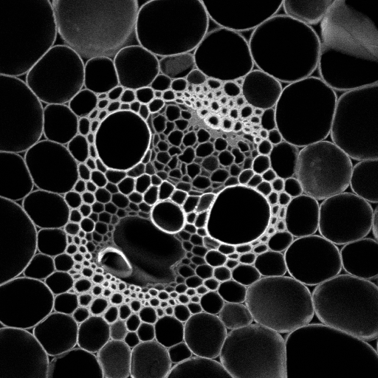
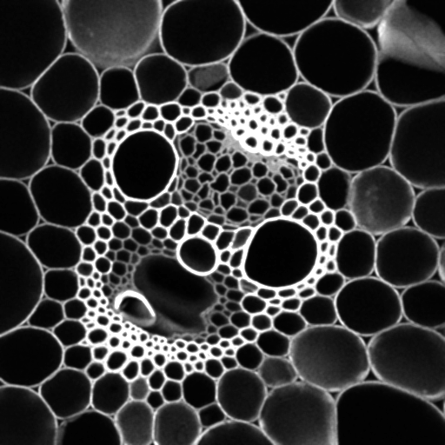
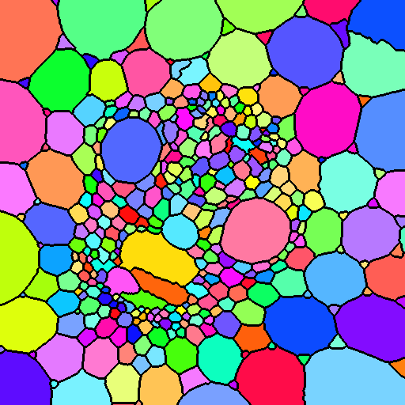
Outline
Filtering & enhancement
Segmentation
Analysis
Morphological filtering
Morphological reconstruction
Watershed
Particle analysis
Texture analysis
nom | Aire | Diamètre
1 | 106338.3 | 361.098
2 | 70218.3 | 295.065
3 | 75126.2 | 305.979
4 | 122860.9 | 391.435
5 | 75484.3 | 306.734
6 | 65021.3 | 283.923
7 | 98862.4 | 348.279
8 | 69997.7 | 294.174
9 | 72672.9 | 298.124
Original image
Filtered image
Segmented image
Results table

Slide 6
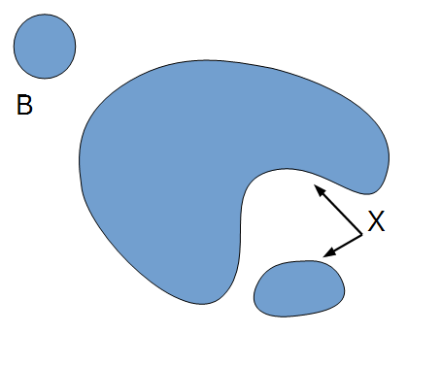
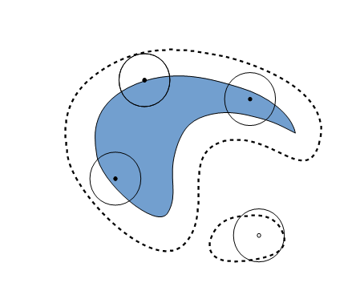
Morphological filters Binary erosion
Set-theoretic operation
Defined by a structuring element (SE)
Does the structuring element fit the set ?

Slide 7
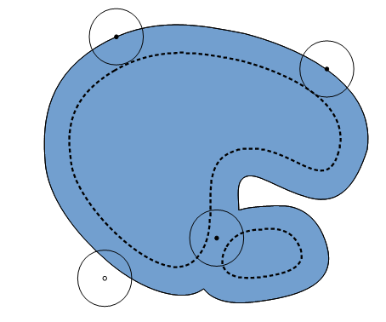
Morphological filters Binary dilation
Set-theoretic operation
Defined by a structuring element (SE)
Does the SE hit the set ?

Slide 8
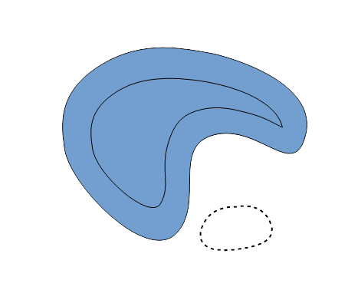
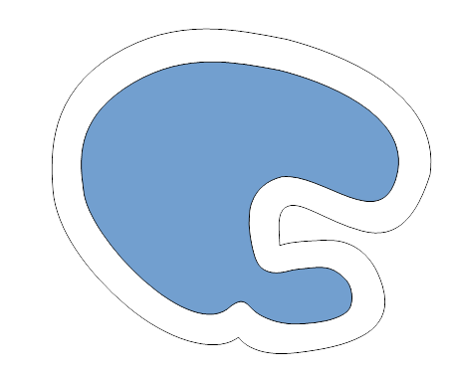
Morphological filters Binary opening and closing
Opening:
Erosion followed by dilation
Remove small objects
Separate components
Closing:
Dilation followed by erosion
Remove small holes
Merge components

Slide 9
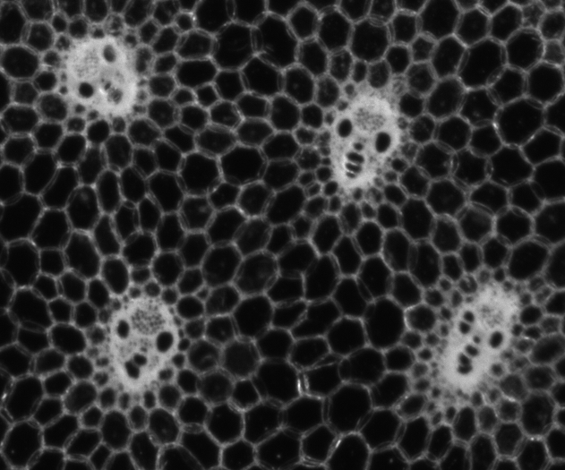
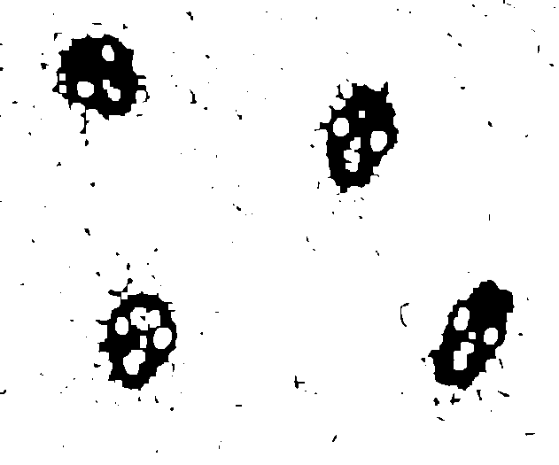

Closing and opening for post-processing of segmentation
image
Raw segmentation
Closing -> removes holes
Opening-> removes “dirts”

Slide 10
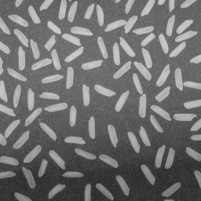
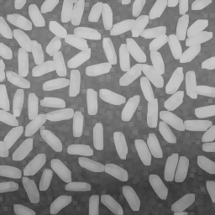
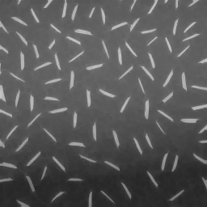
Grey scale morphological filters dilation & erosion
Original image
Dilation result
Erosion result
Dilation: compute maximum value in neighbourhood
Erosion: compute minimum value in neighbourhood

Slide 11
Grey scale morphological filters closing & opening
Original image
Closing result
Opening result
Closing = Erosion ( Dilation (Image) )
Removes small dark structures
Opening = Dilation ( Erosion (Image) )
Removes small bright structures

Slide 12
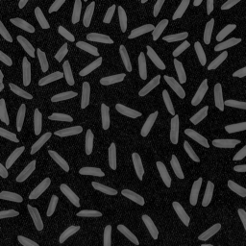
Grey scale morphological filters top-hats (1)
Original image
Opening result
(large SE...)
White Top-hat result
WhiteTopHat(I) = I – Opening (I)
Enhances small bright structures ⬄ rolling ball
BlackTopHat(I) = Closing (I) - I
Enhances small dark structures

Slide 13
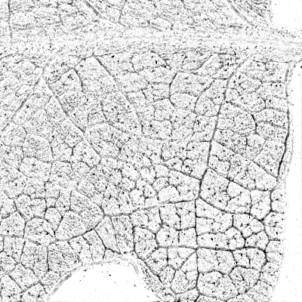
Grey scale morphological filters top-hats (2)
Detection of thin structures / spots
White Top-Hat
Threshold + superposition
Here, we retain small veins and white dots,
while removing thick veins and background

Slide 14
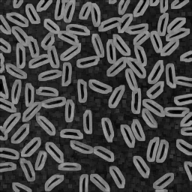
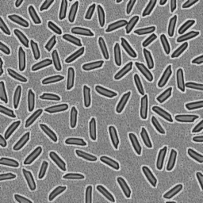
Grey scale morphological filters Gradient(s)
Dilation result
Erosion result
Morphological gradient
Gradient (I) = Dilation (I) – Erosion (I)
a.k.a « Beucher » gradient
Identifies contours
No interpolation artifact
Laplacian (I) = Dilation (I) + Erosion (I) – 2*I

Slide 15
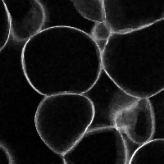
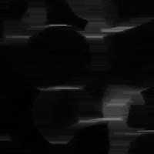
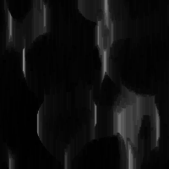
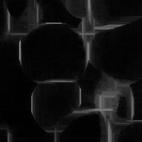
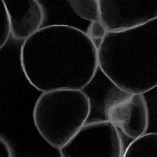
Grey scale morphological filters directional filtering
Original image
Horizontal opening
Vertical opening
Allows for enhancing
linear structures
Max of 2 directions
Max of 16 directions

Slide 16
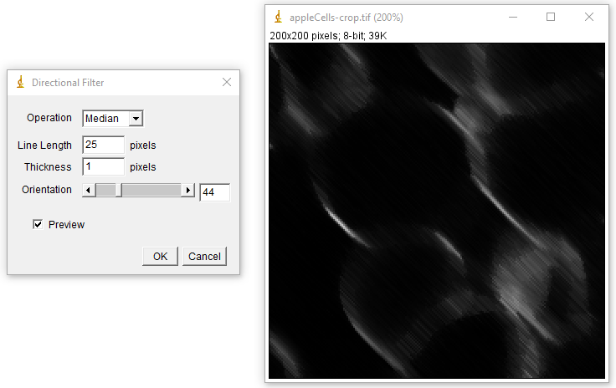
Directional filtering principles demo
Load image:
« appleCells-crop.tif »
Supplementary Plugins
Directional filter
(in « MorphoLibJ Plus »)
Opening or median,
Line length 20
Thickness 1,
Check Preview

Slide 17
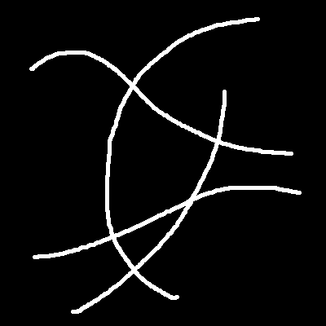
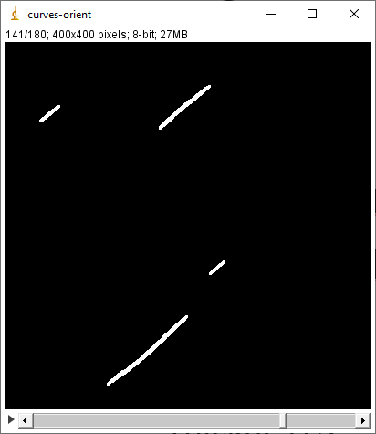
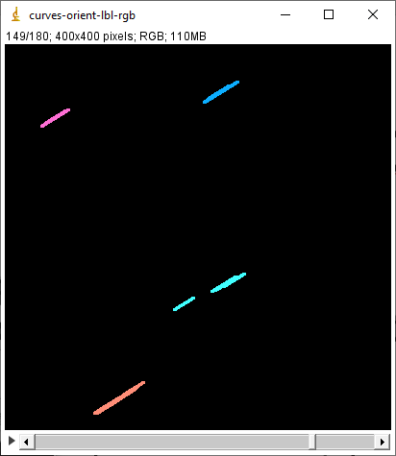
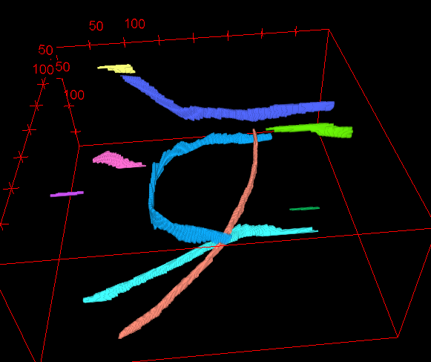
Advanced directional filtering: separation of crossing fibres
Image: “curves.tif”
Orientation stack
(still in « MorphoLibJ Plus »)
Opening
Line length 25
Thickness 3,
180 directions
3D stack of orientation slices
Separate crossing objects
3D display:
Binary Images -> Connected Components Labeling
conn. 6, 8-bits results
Label Images -> « Labels To RGB »
Black BG
3D viewer

Slide 18
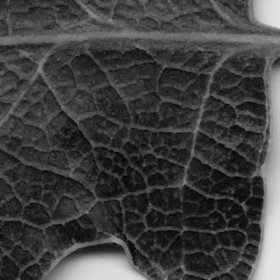
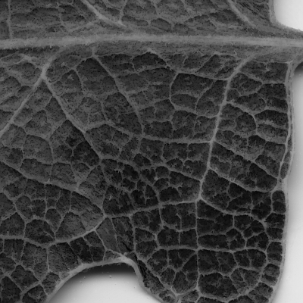
Attribute opening
Opening == removing components based on their “size”
The size of the SE
Can be more generic!
Attribute opening:
Size = number of pixels
Binary/label images: count pixels/voxels
Grayscale image: repeat for each gray level
Here: better preservation of small veins
Original
Opening
(disk R=1)
Attribute Opening (size=10)

Slide 19
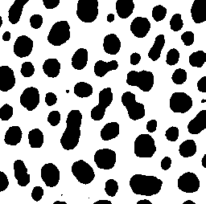
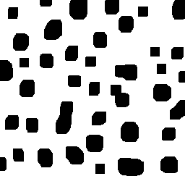
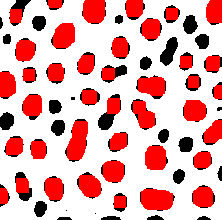
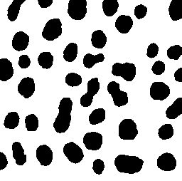
Morphological reconstruction introduction
Problem: (basic) morphological filters tend to modify shape of structures
Idea: keep the original shape of selected regions
Original image
Morphological opening
removes small items
Shape of remaining
items changes...
What we want

Slide 20
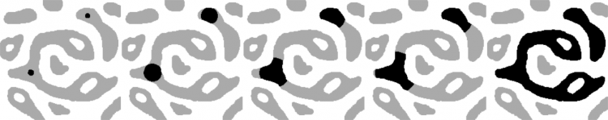
Morphological reconstruction introduction
Principle:
Dilate marker image
Constrain dilation to mask image
Repeat until stability
Used internally in many algorithms
mask
markers

Slide 21
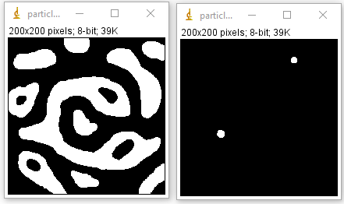
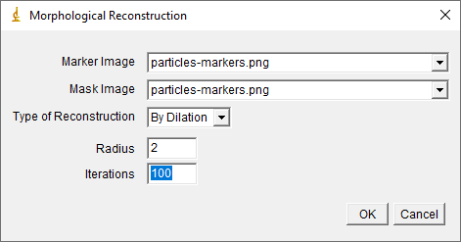
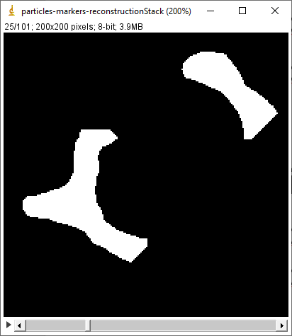
Morphological reconstruction Principles demo
Open images:
« particles »
« particles-markers »
Run plugin:
MorphoLibJ Plus -> Morphological reconstruction demo
Plugin « Morphological reconstruction »
Faster implementation
Works also for grayscale images

Slide 22
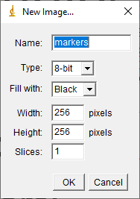
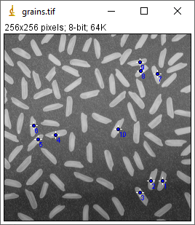
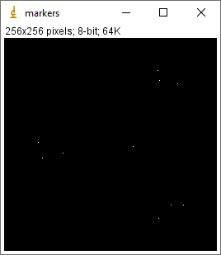
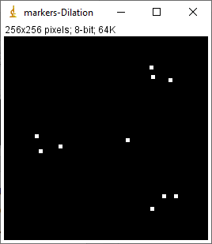
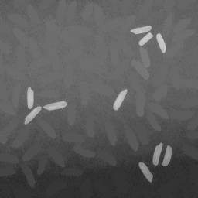
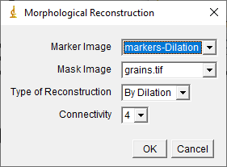
Morphological reconstruction Manual selection bright structures
Input image:
« grains.tif »
Create markers:
File -> New…-> Image
Same size as original
Choose « multi-point » tool
Click on some grains
Copy selection to marker image (ctrl+shift+E)
Draw markers (ctrl+D)
Optional: apply small dilation
Plugins -> MorphoLibJ -> Morphological reconstruction
Check also the “Interactive Morphological Reconstruction” plugin

Slide 23
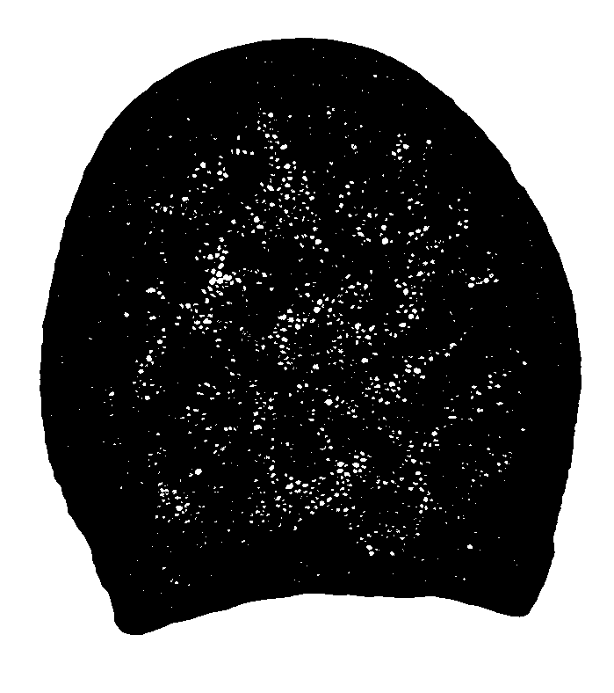
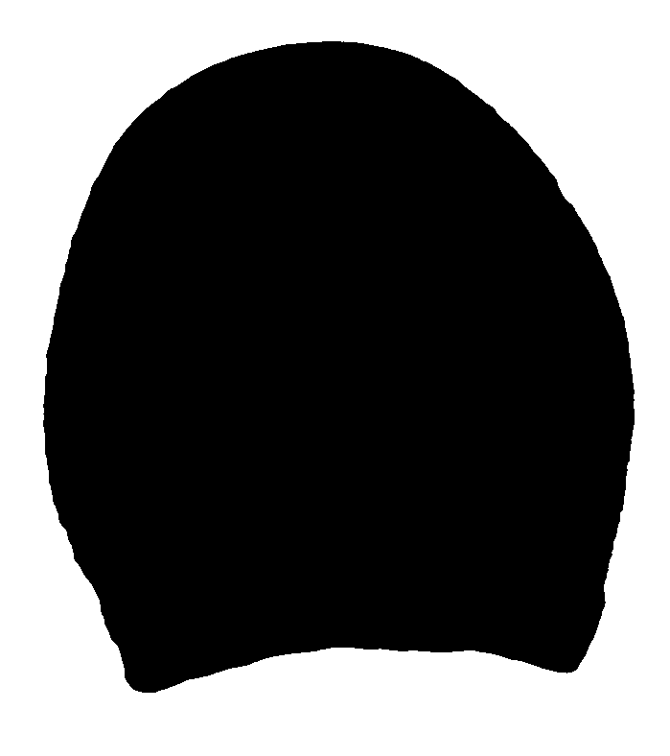
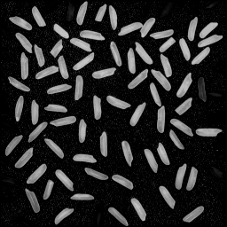
Morphological reconstruction application examples
Kill borders
Fill Holes

Slide 24


Morphological filters summary
Morphological filters:
Post-processing
Grayscale image filtering
Advanced filters
Directional filtering
Attribute opening
Morphological reconstruction:
Selection of specific components
Kill borders or fill holes

Slide 25
Outline
Filtering & enhancement
Segmentation
Analysis
Morphological filtering
Morphological reconstruction
Watershed
Particle analysis
Texture analysis
nom | Aire | Diamètre
1 | 106338.3 | 361.098
2 | 70218.3 | 295.065
3 | 75126.2 | 305.979
4 | 122860.9 | 391.435
5 | 75484.3 | 306.734
6 | 65021.3 | 283.923
7 | 98862.4 | 348.279
8 | 69997.7 | 294.174
9 | 72672.9 | 298.124
Original image
Filtered image
Segmented image
Results table

Slide 26


Segmentation
Objective:
identify the structure(s) of interest in the input image
Output:
Binary image
Label image
Position(s), geometrical models
Example: threshold

Slide 27

Watershed-based segmentation
Use a topographic analogy
Principle:
Consider grey levels as altitudes
Identify local minima
Flood basins starting from minima
Separate the basins by a “dam” -> the watershed
basin
basin
basin

Slide 28

Watershed-based segmentation
Use a topographic analogy
Principle:
Consider grey levels as altitudes
Identify local minima
Flood basins starting from minima
Separate the basins by a “dam” -> the watershed

Slide 29
Watershed limitations
Over-segmentation (too many regions)
due to the presence of many local minima
Original image
Watershed dams
Local minima

Slide 30
Example of watershed
Input image:
“appleCells-smooth.tif”
Or smaller one
eventually smooth or filter
Segmentation operators in:
MorphoLibJ -> Segmentation
Run “Classic Watershed”

Slide 31
Example of watershed
Options:
No mask
Uncheck diagonal conn.
Use default hmin & hmax
Process
[Change colormap]
To see the minima:
MorphoLibJ -> Minima and Maxima -> Regional Min & Max

Slide 32


Watershed with markers
Manually impose the minima over image

Slide 33






Watershed with markers
Procedure
Use “multi-point” selection
Click, click, click...
Create a new image
Same size as original
Fill with black
Copy selection (ctrl+shift+E)
Draw selection (ctrl+D)
[dilate]
Marker-controlled Watershed
Without mask, with dams
No diagonal connectivity
Implemented in:
Alternative
Use minima imposition
MorphoLibJ -> Segmentation -> Interactive Marker-Controlled Watershed

Slide 34


Watershed
Idea: remove unwanted minima
Filtering of input image (gaussian, median...)
Automatically detect minima
Use extended minima

Slide 35



Regional and extended extrema
Regional Maximum:
Set of connected pixels / voxels
With the same value
Such that all region neighbours have lower value

Slide 36


Regional and extended extrema
Extended Maximum: use a tolerance “H”...
Set of connected pixels / voxels
With difference of values < H
Such that all region neighbours have lower values (below max_R(I)-H)

Slide 37
Watershed
Idea: remove unwanted minima
Filtering of input image (gaussian, median...)
Automatically detect minima
Use extended minima
=> Filter basins based on “tolerance”
h₃>t
h₁<t
h₂>t

Slide 38

Implemented with GUIs (for 2D/3D images)
Plugins -> MorphoLibJ -> Segmentation -> Morphological Segmentation

Slide 39

Post-processing
Label Edition plugin
Kill borders – choose borders

Slide 40


More on watershed: segmentation of contrasted object
Situation:
bright object over dark background
(or the contrary)
Idea:
apply watershed on the gradient of image
Gradient can be of any type: linear, morphological)...

Slide 41




Typical Watershed Workflow
Original image
Label Map Image
Edited Label Map
Parametric Map
of morphometry
Region Analysis 3D
Watershed Segmentation
Label Edition

Slide 42
More on watershed (again): separation of binary particles
Input image
Touching nuclei
Separated nuclei
Distance map
WS on reversed DM
WS lines

Slide 43

Morphological segmentation summary
Watershed algorithm
Segment cells
Segment objects
Separate particles
To avoid over-segmentation:
Selection of markers
Manual or auto
Label edition plugin for post-processing operations

Slide 44
Outline
Filtering & enhancement
Segmentation
Analysis
Morphological filtering
Morphological reconstruction
Watershed
Particle analysis
Texture analysis
nom | Aire | Diamètre
1 | 106338.3 | 361.098
2 | 70218.3 | 295.065
3 | 75126.2 | 305.979
4 | 122860.9 | 391.435
5 | 75484.3 | 306.734
6 | 65021.3 | 283.923
7 | 98862.4 | 348.279
8 | 69997.7 | 294.174
9 | 72672.9 | 298.124
Original image
Filtered image
Segmented image
Results table

Slide 45




Quantitative Image Analysis with MorphoLibJ
Morphometry of regions
Size
Shape indices
Spatial organisation
Neighbourhood
Texture analysis¹
Variations of gray levels
¹ https://github.com/ijtools/ijGranulometry

Slide 46



Region analysis
Size
Area, perimeter
Equivalent ellipse
Feret diameters
Oriented bounding box
Geodesic diameter
Shape indices
« Circularity »
Ellipse / box elongation
Convexity
Tortuosity
…
Overlay results
Colorize regions

Slide 47



Region analysis – geodesic features
Geodesic diameter
Length of the largest geodesic path within X
Shape indices
Geodesic elongation
D_{g} / D_{ins}
Geodesic shape factor
(π / 4) * D_{g}² / A
Tortuosity
D_{g} / F_{max}
Path
within X
Geodesic
path within X
Geodesic
Diameter of X
Lantuéjoul & Beucher, 1981

Slide 48

Average Thickness Plugin
New in 1.4.2!
Idea:
Measure thickness along the region main axis
Principle:
Compute skeleton
Compute distance map
Measure distance map only along the skeleton

Slide 49

3D region analysis
Size
Volume, surface area
Equivalent ellipsoid
Inscribed ball
Geodesic diameter
Shape indices
« Sphericity »
Ellipsoid radius ratios

Slide 50

Validation of measurements (1)
How « good » are the measured values?
Validation:
Measure regions with known morphology
Two criteria:
Accuracy (bias)
Precision (variability)

Slide 51



Validation of measurements (2)
Example: surface area
Several methods:
Isosurface
Intercept count
Error may not decrease with resolution!
Lehmann and Legland, 2010

Slide 52
Topology analysis: Region Adjacency Graph (RAG)
Objectives:
Provide information about cell network topology
Help the classification of regions/cells by also considering the neighbours’ features
Measure the « interface » between regions
Original image
Segmentation
Region Adjacency Graph

Slide 53

Morphological granulometry
Image texture analysis
Application of morphological filters with increasing sizes of structuring element
https://github.com/ijtools/ijGranulometry

Slide 54




Mathematical morphology: granulometric curves
Variation of sum
of grey levels (%)
350 µm
10.7 mm
450 µm
Size of structuring element (µm)

Slide 55

Summary
MorphoLibJ = collection of plugins
Morphological filtering
Binary, grayscale, RGB
Morphological reconstruction
…
Segmentation
Watershed
Image analysis
Regions
Topology
Scriptable library
Plugins
Static classes
Algorithms

Slide 56
End
Main references
Legland D, Arganda-Carreras I, Andrey P (2016). MorphoLibJ: integrated library and plugins for mathematical morphology with ImageJ. Bioinformatics, doi:10.1093/bioinformatics/btw413
Soille, P (2003). Morphological Image Analysis. Springer, Second edition
Serra, J. (1982). Image Analysis and Mathematical Morphology. Volume 1, Academic Press
Analysis
Legland D., Kiêu K. and Devaux M.-F. (2007). Computation of Minkowski measures on 2D and 3D binary images. Image Anal. Stereol., 26, 83-92
Ohser J. and Mücklich F. (2000) ‘Statistical Analysis of Microstructures in Materials Sciences’. J. Wiley & Sons
Lehmann, G. & Legland, D. (2009). Efficient N-Dimensional surface estimation using Crofton formula and run-length encoding. The Insight Journal
Applications
Legland, D. & Beaugrand, J. (2013) Automated clustering of lignocellulosic fibres based on morphometric features and using clustering of variables. Industrial Crops and Products, 45, 253 – 261
Devaux, M.-F., Bouchet, B., Legland, D., Guillon, F. & Lahaye, M. (2008). Macro-vision and grey level granulometry for quantification of tomato pericarp structure. Postharvest Biol. Technol., 47, 199-209
Silva JVC, Legland D, Cauty C, Kolotuev I, Floury J. (2015). Characterization of the microstructure of dairy systems using automated image analysis. Food Hydrocolloids, 44, 360 - 371

Slide 58





Label Images: connected components labelling
Connected Components Labelling:
Transform a binary image into a label image
Label ⬄ particle IJ
Results depend on connectivity
For 2D images : 4 or 8
For 3D images : 6 or 26
Binary image
Labels, 4-connectivity
Labels, 8-connectivity

Slide 59









Combining directional filtering + attribute filtering + watershed
Original
Directional filtering
Dir. Filt. - AWTH
Attribute White Top Hat

Slide 60

Morphological filters relationships
White
Top Hat
Dilation
Closing
Gradient
Laplacian
Erosion
Opening
Black
Top Hat

